Slide 1
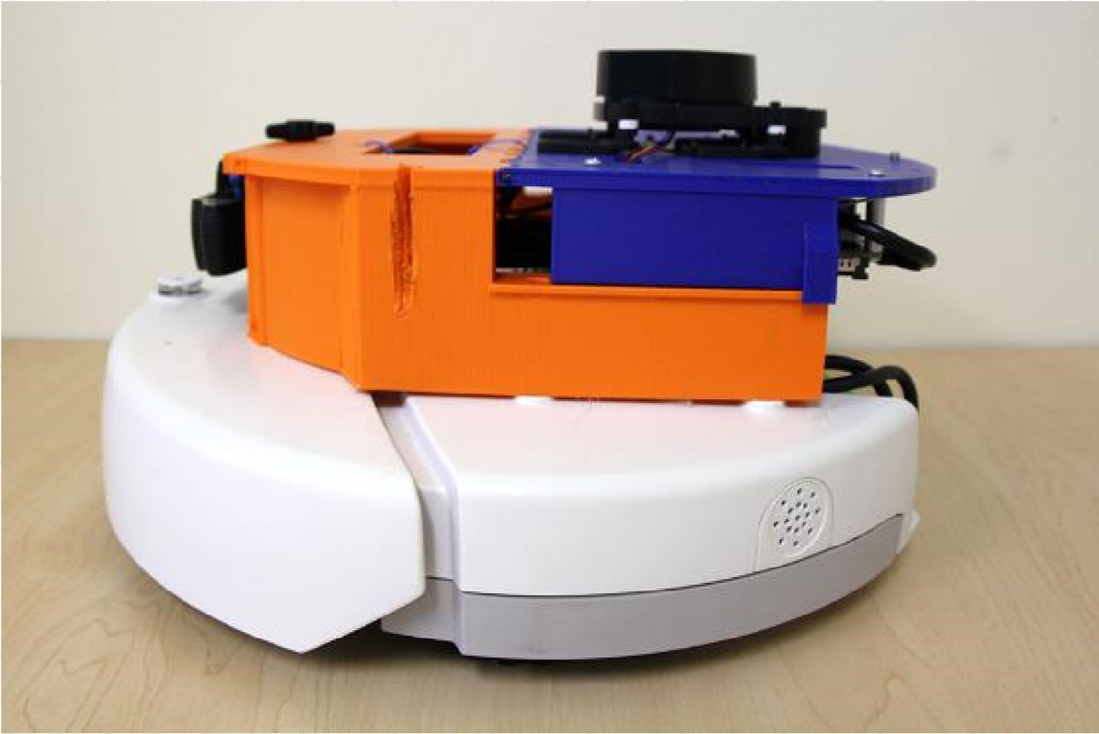
2D LiDAR
Camera
IMU

